Slide 1
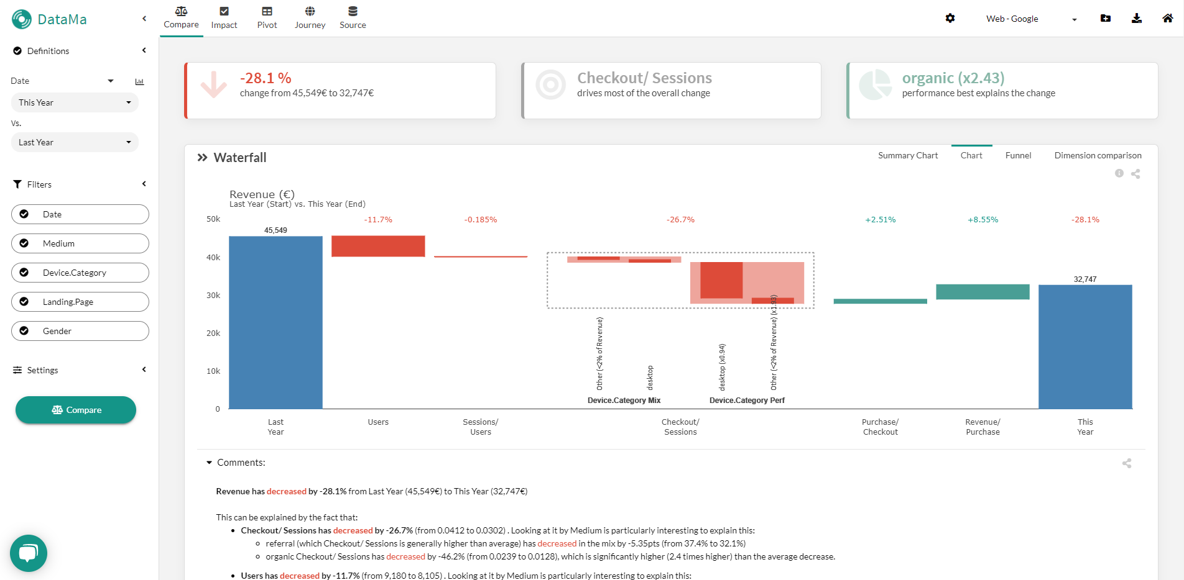
ADMIN HEADER
MENU
DASHBOARD

Slide 2
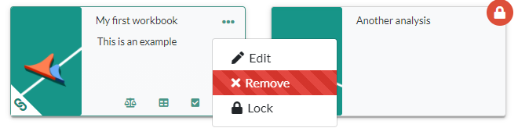
Locked workbook get a specific icon
Click here to edit/ Remove/ Lock a workbook
Solutions linked directly to an external source (Gsheet, Tableau, Drive…) get a symbol
Available DataMa solutions given your licence and the source appear here

Slide 3
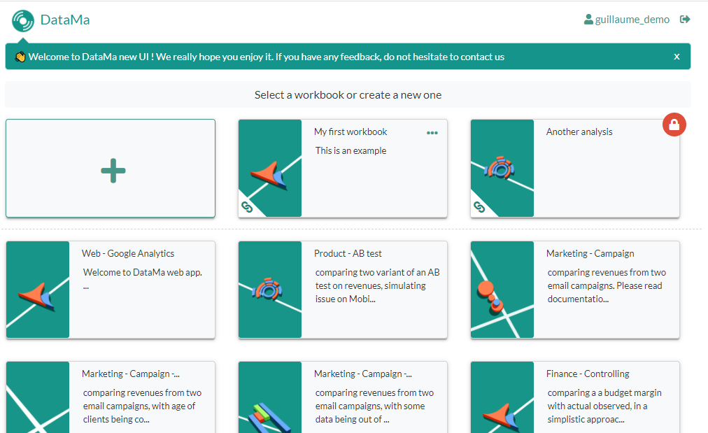
Create a new workbook
Log Out icon
Your saved worbook
Get inspired with examples of workbooks for different typical use cases

Slide 4







Slide 5
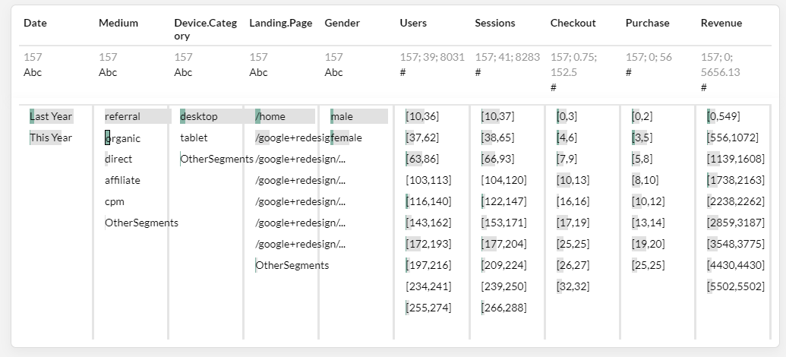
Name of column
Number of lines, median and sum (if continuous)
Number of lines (if discrete)
Data type (Abc = String, #=Integer)
Distinct values, bar size is the sum of selected KPI Numerator in the settings (in green the selected sub set, in grey, the total)

